Slide 1
Housing Development Board (HDB) Rental System

Slide 2
GUIDE
Dr Preethi Kesavan
HOD, School of Tehnology
TEAM
Jayamani Anbalagan U2304775
Vishnu Priya Balashanmugam U2304776
Ayano Kuzuwa U2304777
Abhishek Dhillon U2304774

Slide 3
Introduction
DB stands for The Housing & Development Board, and many properties have been built for years.
New system for Housing Development Board Rental Service (HRS) is developed.

Slide 4
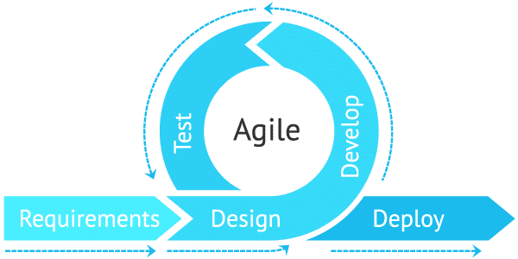
Methodology Used

Slide 5
Agile methodology for software management is followed because it adapts to change easily and quickly.
The team can deliver high quality product, reduce technical dept like maintenance of existing project.
Agile methodology helps to focus more on new feature development, predictive delivery dates, user focused testing and better project control.

Slide 6
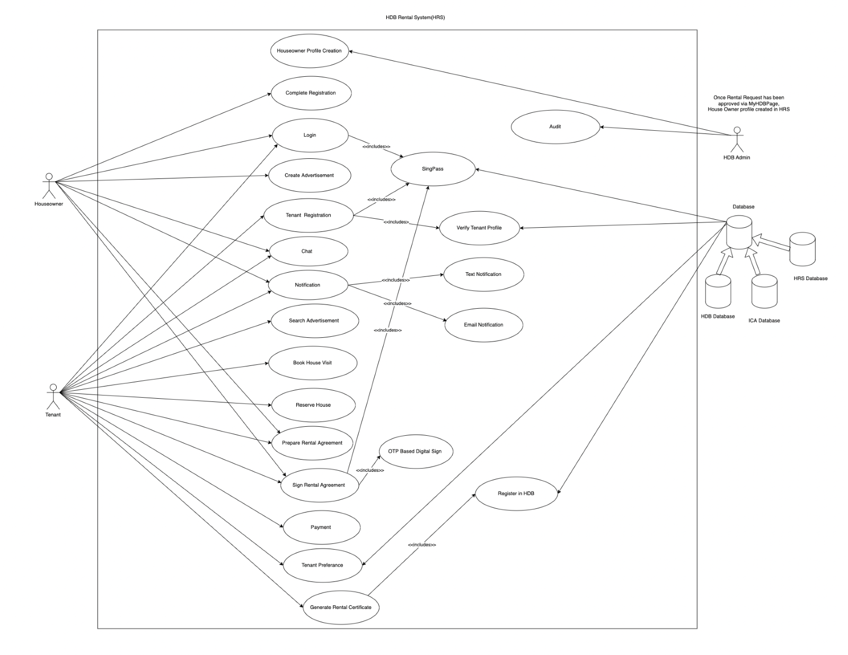
Use Case Diagram

Slide 7
HRS provide complete solution for both houseowners and tenants for rental business with authentic and verified users by interfacing official government databases.
Complete flow of the application explained as per actors with help of UML business usecase diagram

Slide 8
System: HDB Rental System | Usecase: Digital Agreement Sign using OTP system
Primary Actors: 1.Houseowner2.Tenant
Other Actors: NILL
Stakeholders: 1.Houseowner2.Tenant
Description: Houseowner and tenant users use One time password (OTP) to sign rental agreement.
Relationships:<<includes>> - Sign Rental Agreement
Inputs:Enter one time password
Pre-Conditions:1.User should have personal contact number (mobile number).2.Access to Digital Sign Module
Steps:1.Houseowner generate otp.2.Text message with otp send to houseowner mobile phone.3.Houseowner enter the otp.4.System will verify the OTP along with expiration time.5.Once houseowner signed the agreement notification send to tenant user to sign the agreement.6.Tenant generate otp.7.Text message with otp send to Tenant mobile phone.8. Tenant enter the otp.9.System will verify the OTP along with expiration time.10.System verify weather both parties signed then update the agreement status as “Digitally Signed”.
Actors | System
Houseowner Actor:1.Houseowner generate otp.2.Text message with otp send to houseowner mobile phone.3.Houseowner enter the otp. Tenant Actor:6.Tenant generate otp.7.Text message with otp send to Tenant mobile phone.8. Tenant enter the otp. | 4.System will verify the OTP along with expiration time.5.Once houseowner signed the agreement notification send to tenant user to sign the agreement. 9.System will verify the OTP along with expiration time.10.System verify weather both parties signed then update the agreement status as “Digitally Signed”.
Alternative and Exceptional Flows:1.If users didn't not receive otp within 60sec, they can regenerate OTP from UI.2.If user not entered otp within 60sec, otp will be expired, user have to regenerate new otp.3.Only 3 otp can be generated by user in one contempt to sign the agreement, if not success, user have to re-login and then try to sign using OTP.
Post Conditions:1.After receiving the singed rental agreement in email, Tenant has to pay service and registration free to Register his tenancy into HDB.
Use Case Description

Slide 9
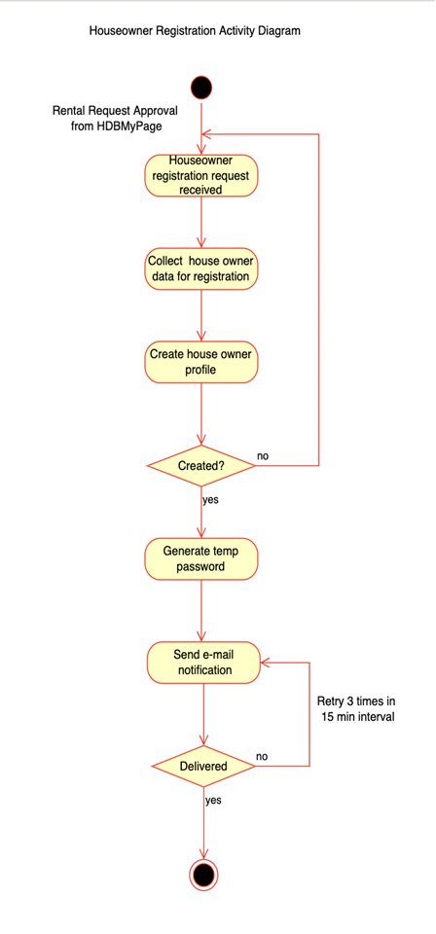
System Design - Activity Diagram

Slide 10
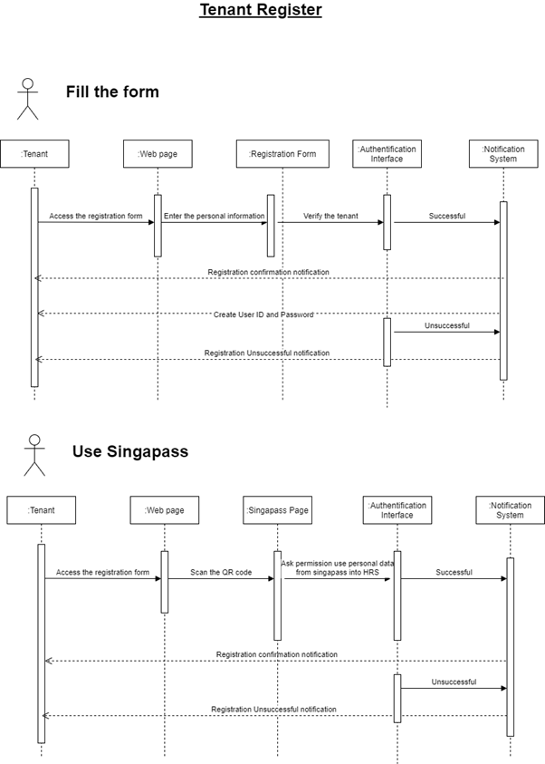
Sequence Diagram

Slide 11
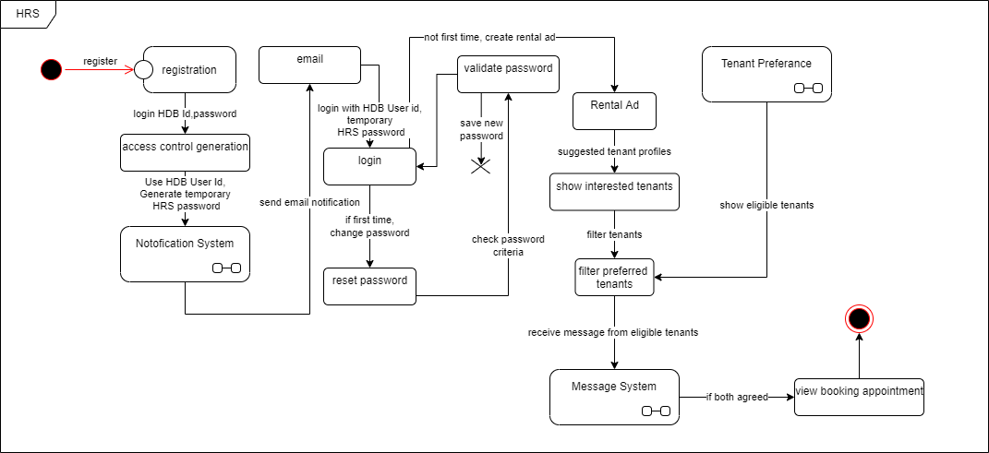
State Chart Diagram

Slide 12
The above state chart diagram shows the flow from one state to another by caring various actions.

Slide 13
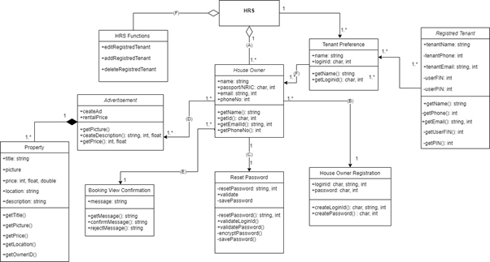
Class Diagram

Slide 14
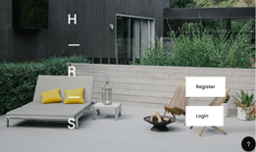
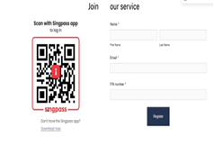
System UX

Slide 15
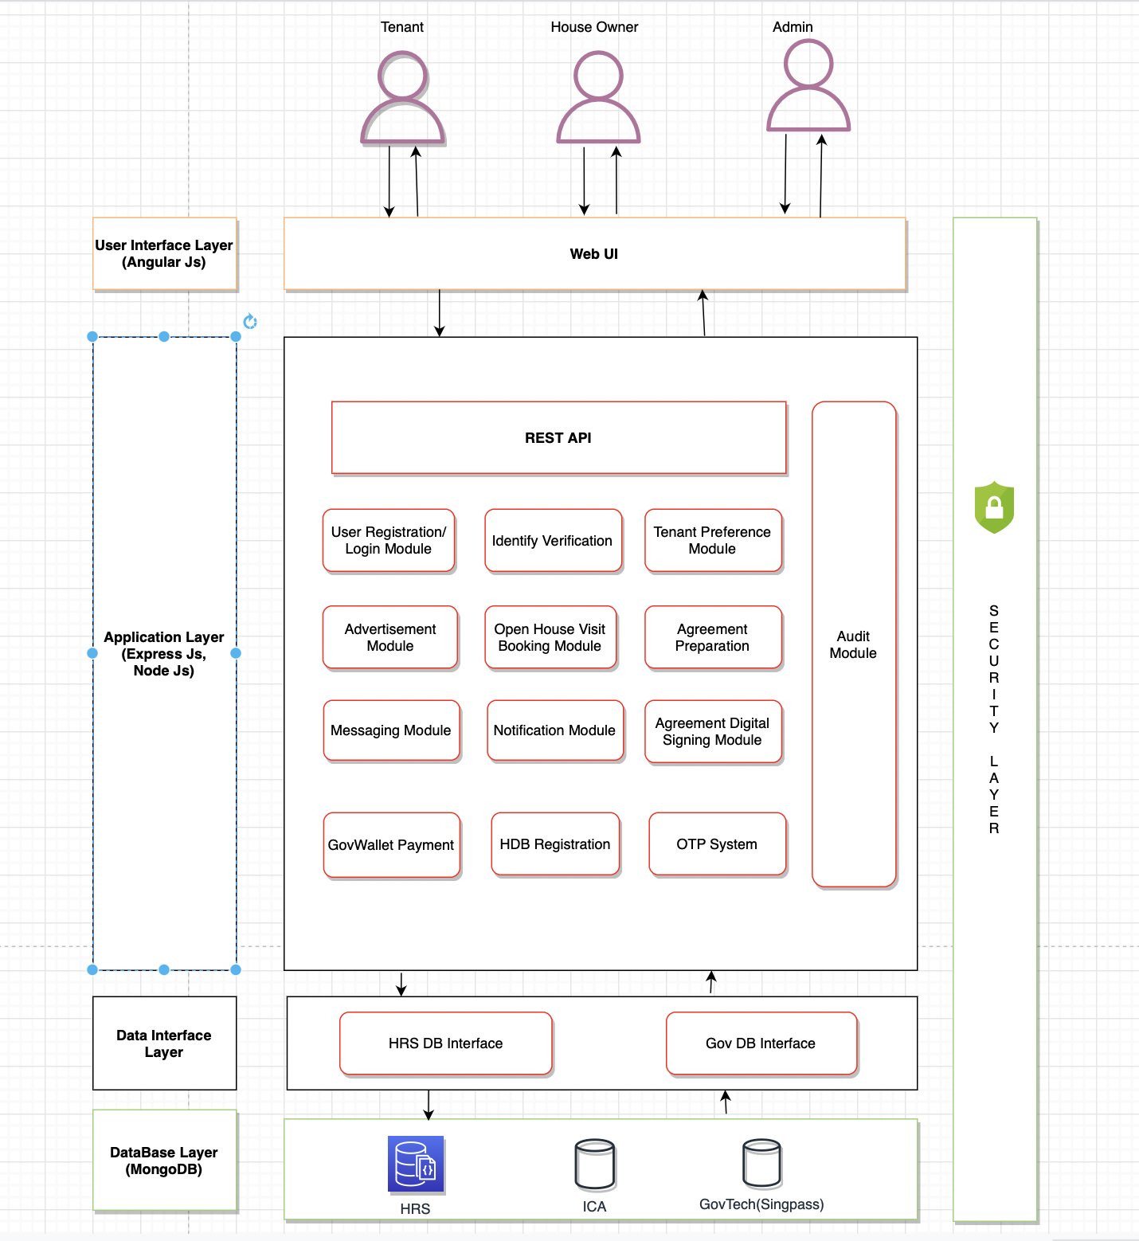
System Architecture

Slide 16
The system architecture design implicates the different layer used in this project.
All these layers are bi-functional where the input is given and the output is fetched.

Slide 17
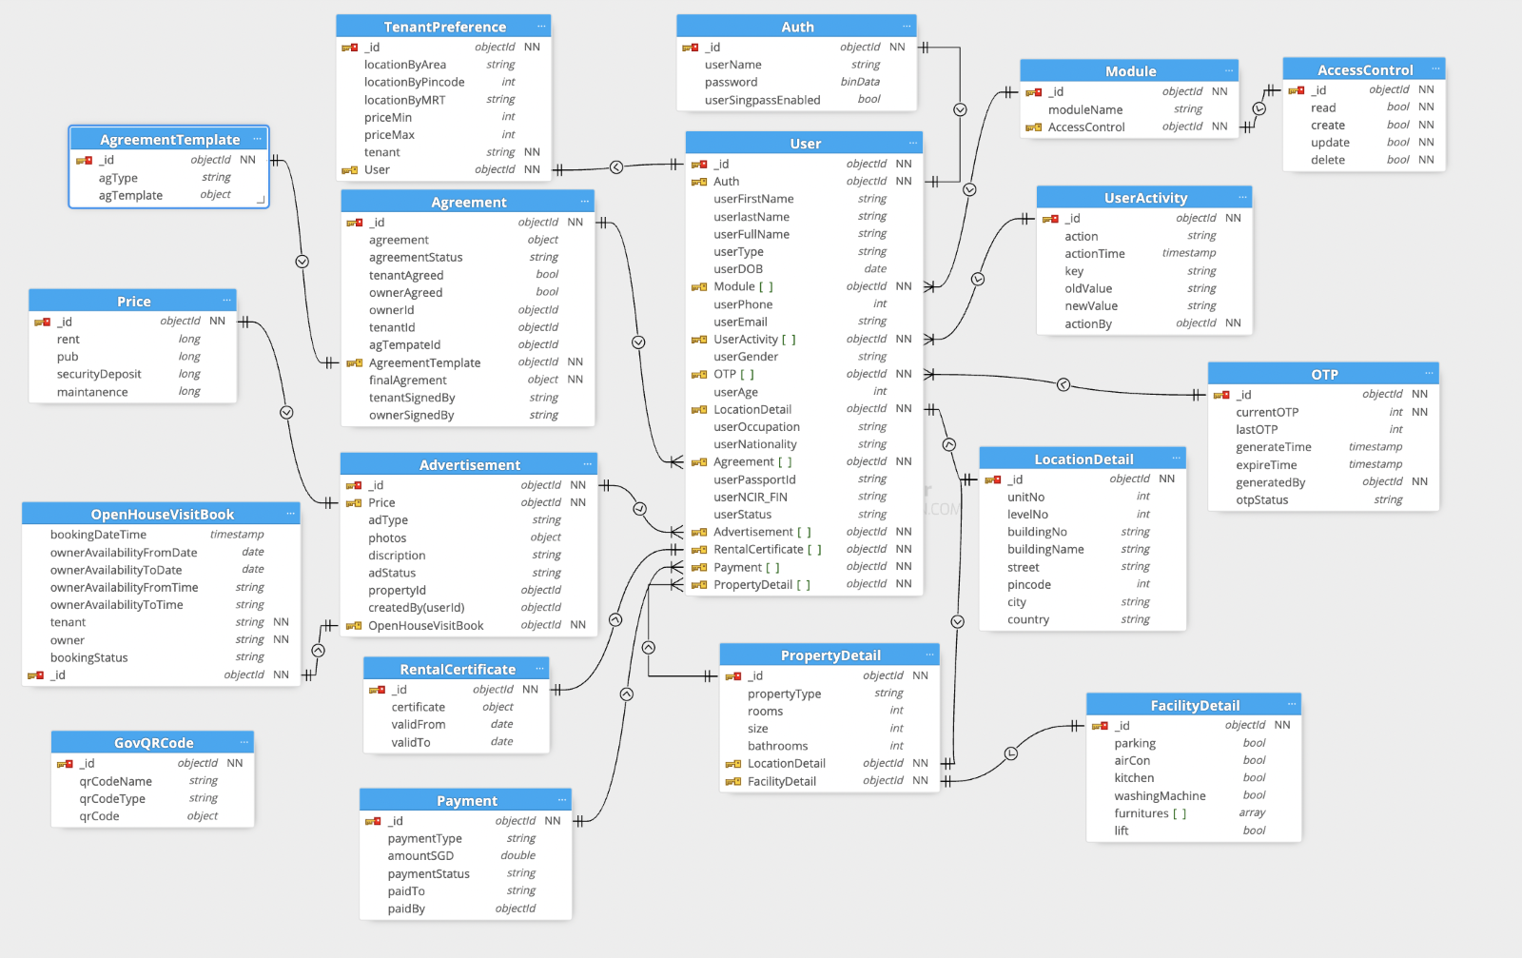
Database Schema - MongoDB

Slide 18
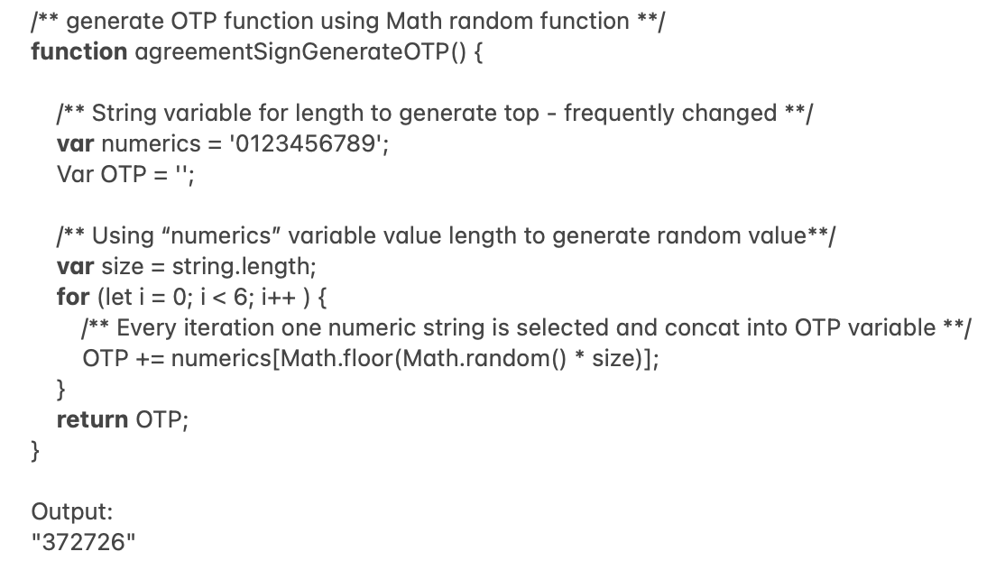
Algorithm

Slide 19
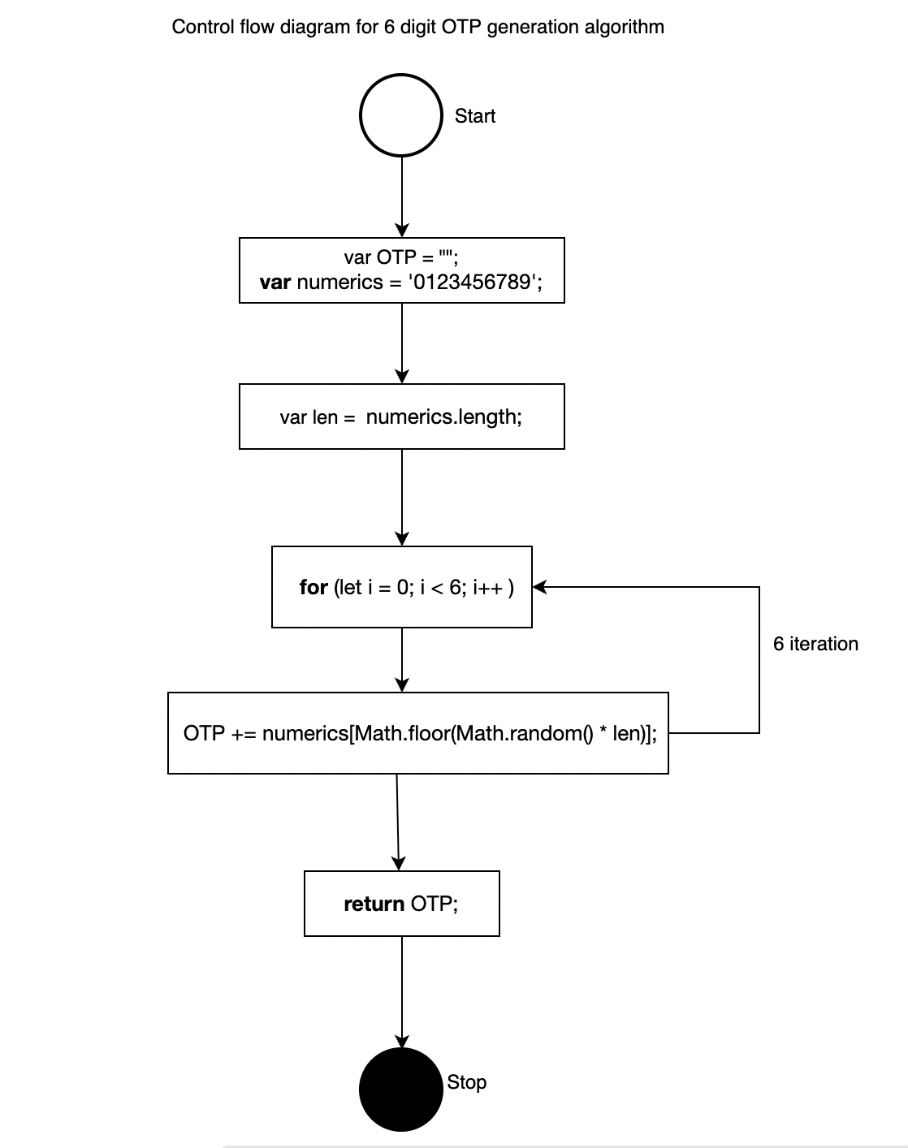
Control Flow Diagram

Slide 20
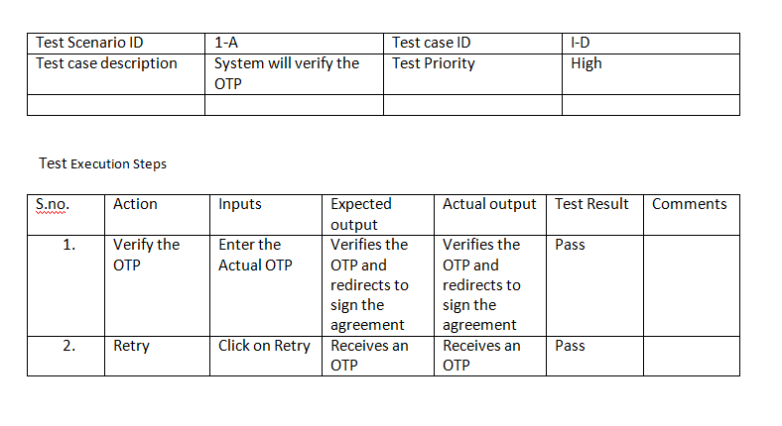
Test Plan

Slide 21
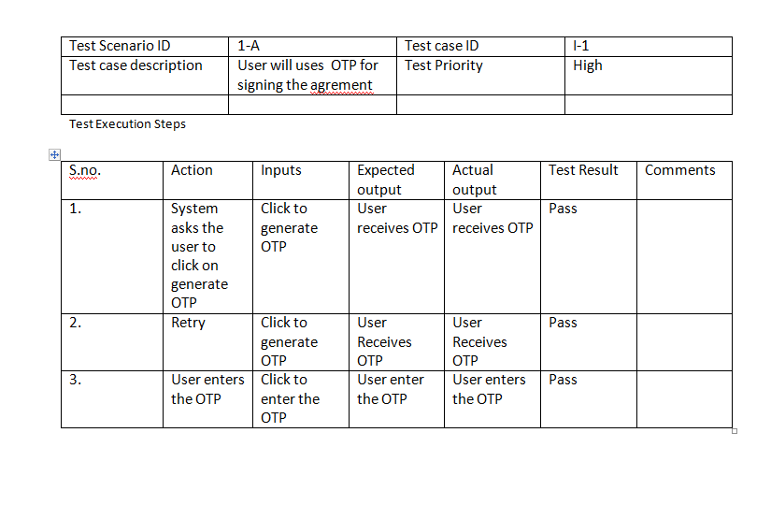

Slide 22
THANKS!
Any questions?

